Slide 1



SMART INDIA HACKATHON 2025
TITLE PAGE
Problem Statement ID- SIH25070
Problem Statement Title- Secure Data Wiping for Trustworthy IT Asset Recycling
Theme- Miscellaneous
PS Category- Software
Team ID-
Team Name- (CyberSanctrix)
SIH 03

Slide 2
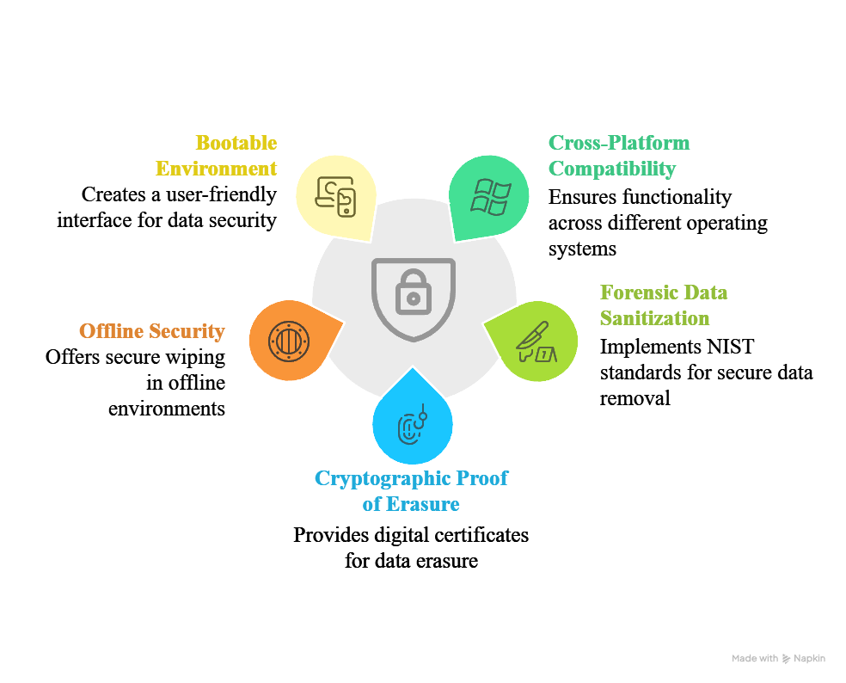


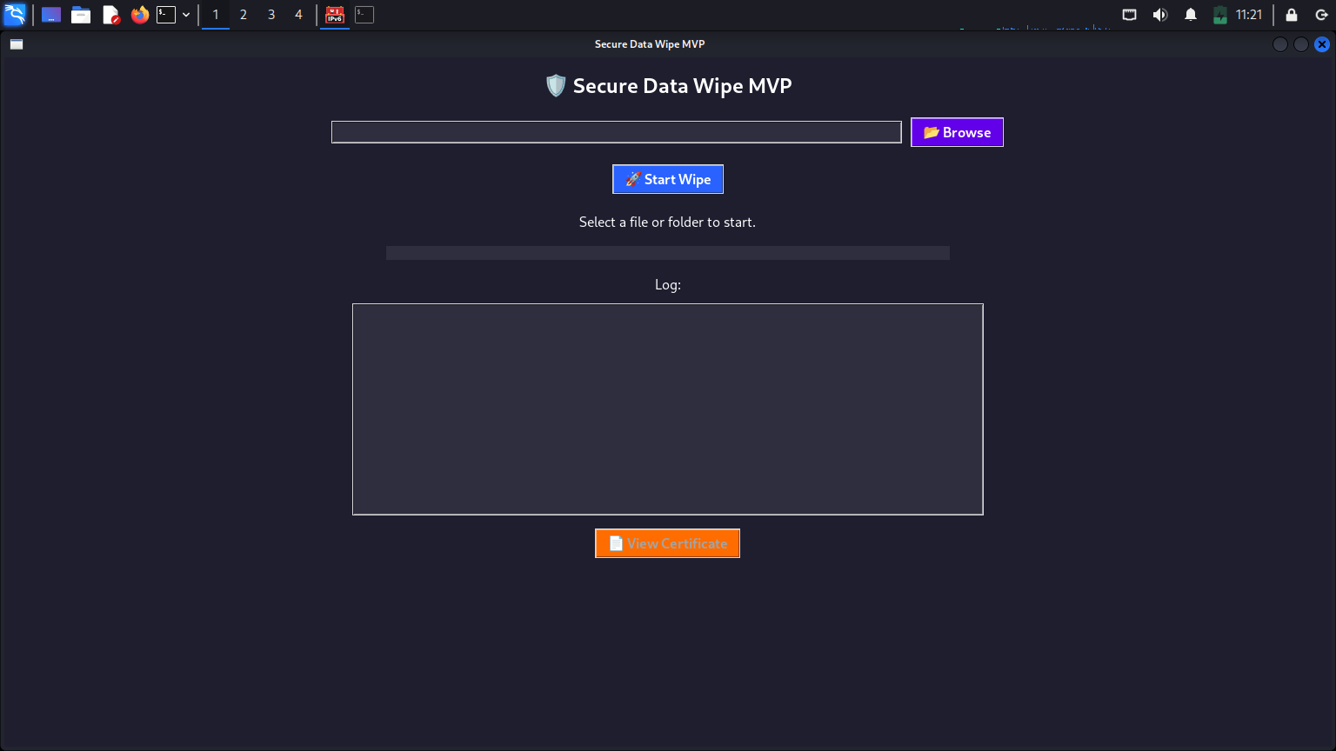



CyberSanctrix
IDEA TITLE
Proposed Solution-
Innovation & Uniqueness-
Tamper-Proof Certificates → Digitally signed, legally verifiable proof of data erasure.
Regulatory Compliance → Meets GDPR, HIPAA & DPDP Act (India) requirements.
Dual Mode Operation → Works both offline (bootable) & online (cloud integration).
Scalable & Flexible → From personal devices to enterprise-level bulk wiping.
Eco-Friendly Impact → Promotes safe IT asset recycling & e-waste reduction
2
Notes:
2

Slide 3
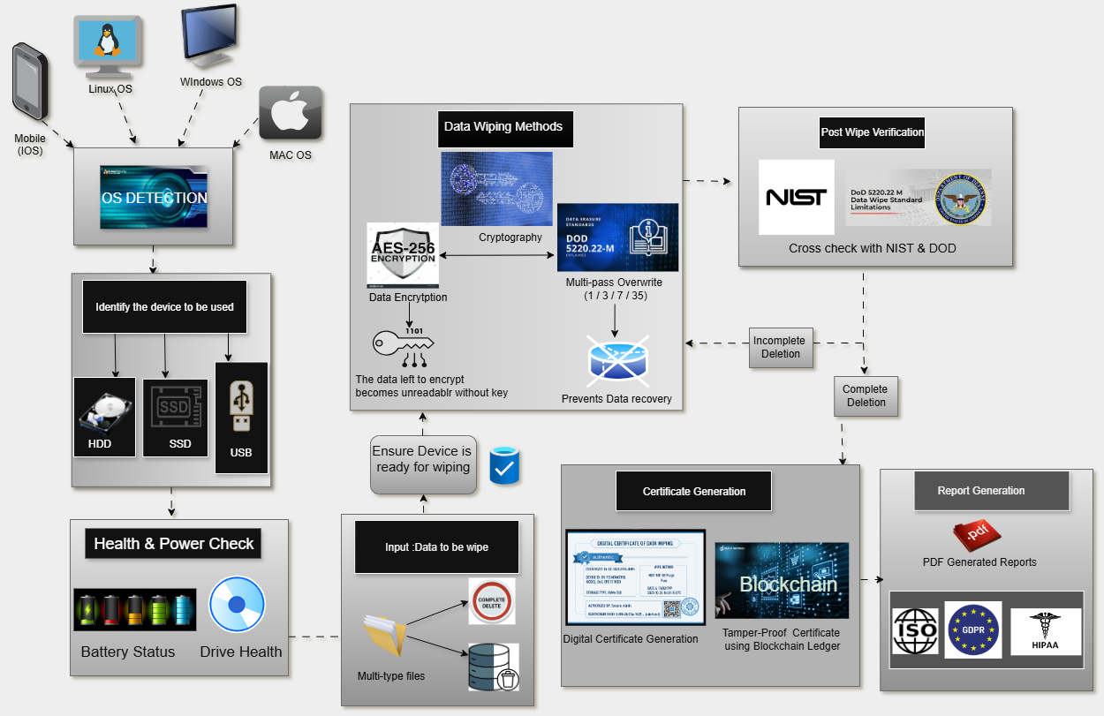
TECHNICAL APPROACH
CyberSanctrix
Data Wiping Workflow
OS Detection
Identifies device type: Windows, Linux, or Mobile
Health & Power Check
Ensures hardware stability before wiping
Data Selection
User chooses files, partitions, or full drive
Wiping Methods
Multi-pass Overwrites (DOD 5220.22-M standard)
Cryptographic Erasure (ATA/NVMe commands for instant secure wipe)
Post-Wipe Verification
Cross-checks storage sectors
Aligns with NIST & DOD standards
Digital Certificate Generation
Blockchain-backed, tamper-proof proof of compliance
Ensures audit readiness & legal validity
3
Notes:
3

Slide 4

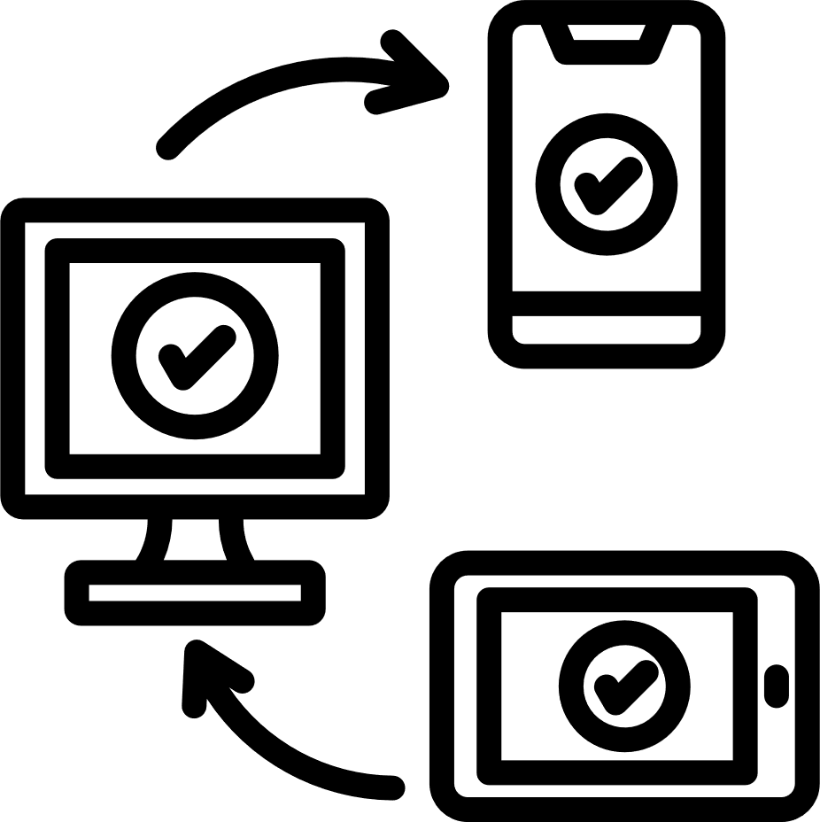
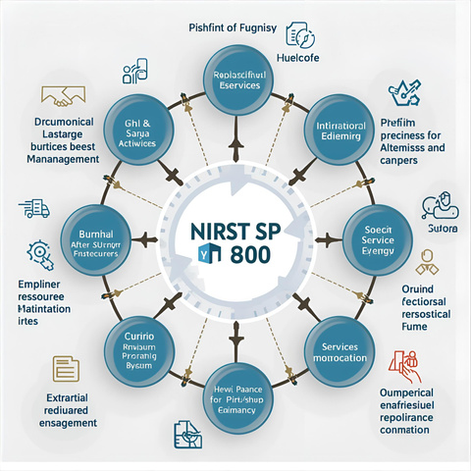




FEASIBILITY AND VIABILITY
CyberSanctrix
Feasibility-
Challenges-
Strategies-
Automate ATA/NVMe commands for full storage wipe.
Leverage public key infrastructure for certificate signing.
Regular compliance audits and software updates.
Utilize open-source communities for support and cost minimization.
Cross-Platform Support → Works on Windows, Linux, Android
SSDs with proprietary features may require specialized erasure methods.
Certificate trust relies on proper cryptographic implementation.
Device boot protection may block USB access.
Hardware driver updates required for new models.
Frequent regulation updates affect compliance routines.
NIST SP 800-88 Aligned → Meets international standards
Hardware-Level Wiping → ATA, NVMe, SCSI commands for secure erasure.
Business Potential-
Tamper-Proof Certificates → Digital proof of deletion for compliance.
Huge Market → $14B industry by 2032; India’s 1.75M tonnes e-waste/year.
Target Users → Enterprises, recyclers, govt, individuals.
Revenue Model → Freemium + SaaS + certification.
Our Edge → Affordable, cross-platform, Made-in-India, compliance-ready.
Cost-Effective Build → Uses open-source tools, reducing cost.
4
Notes:
4

Slide 5








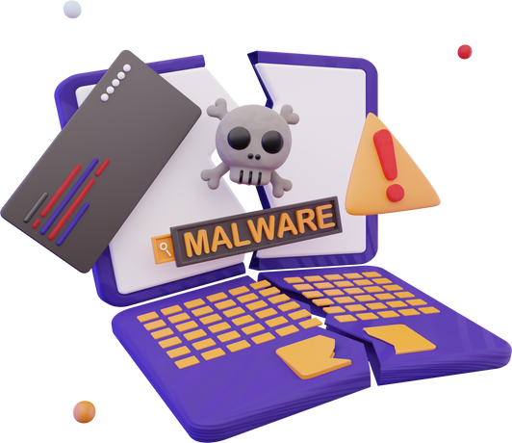



IMPACT AND BENEFITS
CyberSanctrix
Impacts-
Benefits-
Simple UI – Easy to use for any technician
Automation – Auto device detection & wipe
process
Unlock ₹50,000+ Crore in dormant IT assets
Promote the responsible reuse, repair, and refurbishment
Data Security – No data leakage, 100% secure wipe
Secure by Design – Uses cryptographic erase where
possible
Audit-Ready – Signed certificate for legal protection
Low Cost – No physical destruction, reusable devices
Build public trust in national e-waste management
Malware-Free – Removes hidden malware & rootkits
Meets global standards (NIST, GDPR)
Enterprise-Ready – Handles bulk devices efficiently
5
Notes:
5

Slide 6
RESEARCH AND REFERENCES
CyberSanctrix
SEER - "From Cyber Threat to Data Shield" (2025)
https://arxiv.org/pdf/2504.11744.pdf
Comparison of Existing Tools vs Our Solution-
Feature | Blancco Drive Eraser | DBAN | Our Solution (CyberSanctrix)
Cost | Very expensive | Free, but outdated | Affordable (Freemium + SaaS)
Ease of Use | Requires trained IT staff | Complex boot setup | One-click, user-friendly
Platform Support | Windows & Mac (limited Linux) | Mainly HDD (no Android/SSD TRIM) | Windows, Linux, Android
Compliance Proof | Yes (NIST 800-88) | ❌ No certificate | ✅ Digital, tamper-proof wipe certificate
Target Users | Enterprises only | Tech-savvy individuals | Enterprises, Govt, Recyclers, Individuals
India Focus | Global only, no DPDP focus | ❌ None | ✅ Made-in-India, DPDP Act ready
Offline Support | Limited boot ISO | Boot-only, no flexibility | ✅ Bootable ISO + Offline wiping
SevDel - "Accelerating Secure and Verifiable Data Deletion" (2023)
https://arxiv.org/pdf/2307.04316.pdf
) CPAD - "Assured Data Deletion with Fine-grained Access Control" (2018
https://arxiv.org/pdf/1804.02834.pdf
E-Waste & Data Security Research
Microsoft Word - 8-Prashant Kumar Chauhan-CYBERSECURITY_RISKS_IN_E-WASTE_MANAGEMENT-Article-LAW-52-58
Data Sanitization & NIST Standards Research
https://thesai.org/Downloads/Volume10No11/Paper_55-Data_Sanitization_Framework_for_Computer_Hard_Disk_Drive.pdf
NIST Special Publication 800-88 Rev. 1: https://csrc.nist.gov/pubs/sp/800/88/r1/final
6

